Slide 1
Property IT Requirements
Discussion Document

Slide 2
Site Research Findings
Agenda:
Introductions, set expectations, explain purpose of the meeting
Review current understanding of US Property IT issues relative to current state and group offering
Address scoping questions, Discuss Gaps and critical issues
Review Design Validation approach and session responsibility (Tony, Mark, Steve)
  Build Facilites
  Maintain Facilites
  Cost to Build
  Asset Management
Confirm desing validation requirements for Tony

Slide 3
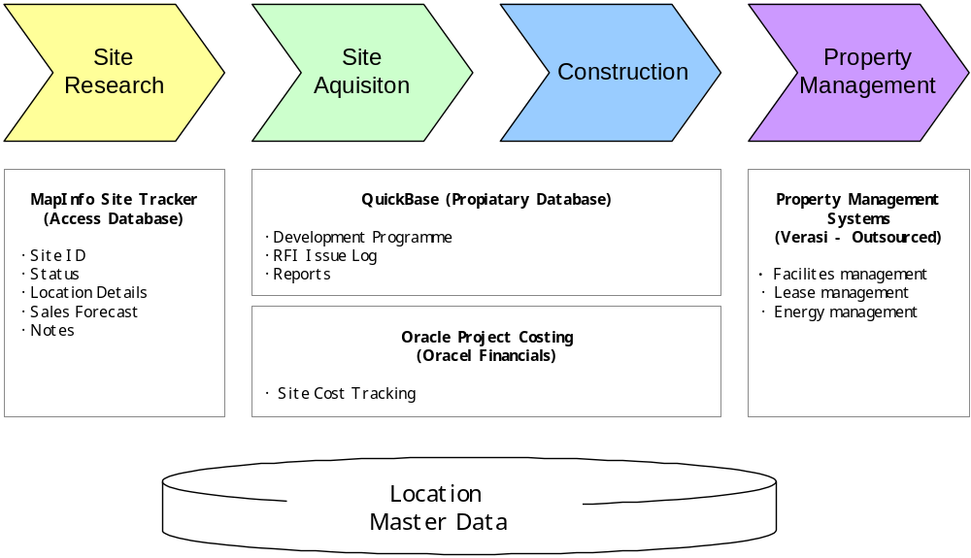
Property Functional Overview

Slide 4
Site Acquisition / Construction Findings
Critical Business Requirements:
Centralized issue log to track RFI’s between Tiger and Development Partners
Centralized location database to manage site details, current status, and drive reporting requirements
Workflow capabilities to manage communication between Tiger Property, Developers, Attorneys, Insurance, Contractors
End to end project cost tracking with Oracle Financials
Technical Issues:
No database solution being utilized, heavy reliance on spreadsheets
Manual communication and email are being used to track issues logs
Non standard procedures for each development partner
Property Team is evaluating QuickBase for a communication / workflow management solution

Slide 5
Property Management Findings
Current Understanding:
Property Management functions will be outsourced to an un-named partner
US Property has requested that partner implement and use Verisai Property management software for facilities management, and lease administration.
Energy Management requirements need to be defined further
Issues:
Possible integration points with third party property management provider and Versai Software
Operations processes for initiating maintenance request and potential integration between “Retail” and Property Management need to be defined

Slide 6
QuickBase Overview
The US Property Team is evaluating QuickBase to enable project and workflow management for the following Site Acquisition and Construction activities:
  Development Programme scheduling and progress tracking
  Issue logging and tracking for construction RFI’s
  Construction Project communication and reporting
Quick base has been recommend by one of the construction development partners
Web Based application hosted by Intuit; templates, reports and issue logs would be custom developed and maintained by QuickBase
Vendor has provided an initial product demo and high level cost proposal to the Property Team
The Property Team is working with Development Partners and Attorneys to coordinate functional requirements gathering for custom templates and reports

Slide 7
QuickBase Cost Overview
Property Services TOM Level 1 Process | Group Solution | IT Governed Solution | Current US Solution | Proposed Local Solution | Comments
Set the Store and DC Development Programme | No | no | Excel | Quickbase
Create Format Blueprints for Store Types | No | No | Third Party CAD | TBD | Outsourced to Architecture / Development firms may nned a centralized repository for CAD files
Set Store Design Standards | N/A | N/A | N/A | N/A | Business Process, No Application support
Set Engineering and Fire Safety Standards | N/A | N/A | N/A | N/A | Business Process, No Application support
Set Standard Build Costs create | N/A | N/A | N/A | N/A | Business Process, No Application support
Feasability Site Plans for Stores | No | No | Site Tracker | Site Tracker | Investigate means to migrate stoire tracker access database to an enterprise DB that is managed
Create Development Budgets | No | No | Excel | Excel | Budgets are being managed via spreadsheet, possible need to feed line level budget details to a database / app to enable plan vs actual cost comparisons and KPI tracking
Implement Design Standards to Development Plans
Develop Store Construction Plans | No | No | CAD | N/A | Outsourced to Architects
Develop DC Construction Plans | No | No | CAD | N/A | Outsourced to Architects
Build for Less | N/A | N/A | N/A | N/A | Business Process, No Application support
Tender for Construction, Agree and Sign Contracts | No | No | Excel / Email | Quickbase | For workflow management
Build Facilities (Stores, DCs, Head Office) | No | No | Excel / Email | Quickbase | For workflow management
Pay for Construction and Maintenance | Yes | Yes | Excel | Oracle Project Costing | Possible link to Verisae
Maintain Facilities (Stores, DCs, Head Office) | No | YesVerisae link of information on assets to depreciation schedules, etc. | None | Verisae | US Property is looking to facilities management outsource partner to install and use verisae, need to understand integration possibilities with Oracle E-Biz
Reduce Energy Use | No | Yes | TBD | TBD
Refit Stores | TBD | TBD | TBD | TBD | TBD

Slide 8
Property Services Application Overview
Property Services TOM Level 1 Process | Group Solution | IT Governed Solution | Current US Solution | Proposed Local Solution | Comments
Feasability Site Plans for Stores | No | No | Site Tracker | Site Tracker | Investigate means to migrate store tracker access database to an enterprise DB that is managed
Create Development Budgets | No | No | Excel | Excel | Budgets are being managed via spreadsheet, possible need to feed line level budget details to a database / app to enable plan vs actual cost comparisons and KPI tracking
Implement Design Standards to Development Plans | N/A | N/A | N/A | N/A | Business Process, No Application support
Develop Store Construction Plans | No | No | CAD | N/A | Outsourced to Architects
Develop DC Construction Plans | No | No | CAD | N/A | Outsourced to Architects
Build for Less | N/A | N/A | N/A | N/A | Business Process, No Application support
Tender for Construction, Agree and Sign Contracts | No | No | Excel / Email | Quickbase | For workflow management
Build Facilities (Stores, DCs, Head Office) | No | No | Excel / Email | Quickbase | For workflow management
Pay for Construction and Maintenance | Yes | Yes | Excel | Oracle Project Costing | Possible link to Verisae
Maintain Facilities (Stores, DCs, Head Office) | No | YesVerisae link of information on assets to depreciation schedules, etc. | None | Verisae | US Property is looking to facilities management outsource partner to install and use verisae, need to understand integration possibilities with Oracle E-Biz
Reduce Energy Use | No | Yes | TBD | TBD | EnergyICT preferred solution but not in the box yet
Refit Stores | TBD | TBD | TBD | TBD | TBD

Slide 9
QuickBase Cost Overview
Service | Fee Type | Initial Cost | Monthly Cost 1-3 months | Monthly Cost (4th Month On)
Initial cost of use (WPIIDC Intellectual Property | Fixed Fee | $ 7,500.00 | $ 0.00 | $ 0.00
Identify and analyze client’s specific requirements: $120/hr | Estimated Fee | $ 2,160.00 | $ 0.00 | $ 0.00
Populate QuickBase to client specific needs: $120/hr | Estimated Fee | $ 1,920.00 | $ 0.00 | $ 0.00
Provide and support training of Core Users: $120/hr | Estimated Fee | $ 4,080.00 | $ 0.00 | $ 0.00
Ongoing monthly maintenance / management of QuickBase: $120/hr | Estimated Fee | $ 0.00 | $ 2,400.00 | $ 1,500.00
Monthly Fixed Fees (Number of QB Users / Data Storage) | Fixed Fee | $ 0.00 | $ 500.00 | $ 500.00
 | Total Cost | $ 15,660.00 | $ 2,900.00 | $ 2,000.00
-database solutions for 1) location details and 2) programme management -
no Group solution as yet identified
-drawing AutoCAD and Space systems (JDA?) interaction re fixture ordering -
work in progress with Janet's team/tbc (but outside Tony's remit - I'm not
even sure if Steve or Mark will work with vendors on fixture orders, as
Steve will know all the detail.)
-drawing database for design standards and/or format blueprints - Steve
Ryder's A, not Tony
-budgetting tool - no Group solution (spreadsheept/PC soution works but
most likely is internal to Property team for use with QS consultants only)
-Construction project management -communication control, process flow - no
Group solution, could be part of database solution from item above
-Maintenance - Verisae (IT governed for UK and Thailand rollout in
progress, not officially in the box yet for reasons explained to you)
-Oracle Project Costing - for procect cost tracking and manage
invoice/payment process, variation control and reporting spend versus
budget. To be confirmed who inputs data in US, Property (value management
function in international) or Finance
-energy management - EnergyICT preferred solution but not in the box yet
(not governed by IT system selection process, no global contract)
-refrigeration monitoring/control - Danfoss or equal, not in the box (no
building control systems follow IT system selection process or have global
contracts)
-) - no Group solutions,
best practice performance requirements could be discussed for local
solutions
-fixed asset tracking - Finance "A" (Remco) related to Build and Maintain
only in possible Verisae link of information on assets to depreciation
schedules, etc.
(as I said on our call, the link I am aware of to Oracle is for work order
processing to Finance for payment, I will try to call Jeremy White today to
clarify.)

Slide 10
Next Steps:
Confirm need and identify potential solutions to provide centralized location data for Property Systems
Validate go forward approach with QuickBase and schedule requirements gathering sessions
Confirm property (Build & Maintain) scope for design validation sessions
Prepare for project costing design validation sessions
Select Property management provider and define design validation requirements for operation processes

